Slide 1


NS
LECTURE
Application Identification (App ID)
Network Security
Diploma in CSF
Year 3 (2020/21) Semester 5
4
Notes:
Left-hand Bar – Replace FSP by your module code and X by the lecture number.
Replace Lecture Title
Replace < Module Name >
Replace Year and Semester if necessary

Slide 2
Agenda
Application Identification (App-ID)
Overview
Components
Security Policy Configuration
Match Conditions and Objects
Application Dependencies
Security Policy Administration
Managing Displays
Managing Policy Behavior
Logs and Reporting

Slide 3
Flow Logic
Initial Packet Processing
Source Zone / Address
Security Pre Policy
Check Allowed Ports
Application
Check for Encrypted Traffic
PBF/
Forwarding Lookup
NAT Policy
Evaluated
Decryption Policy
Security Policy
Post Policy Processing
Session Created
Application Override Policy
App ID
Check Security Policy
Check Security Profiles
Re-Encrypt Traffic
Packet Forwarded
NAT Policy Applied
Destination Zone
Notes:
Once the initial packet processing is complete, the Palo Alto Networks firewall examines the traffic to accurately apply the security policies. Though the device can classify traffic by port like a traditional firewall, the next-generation firewall is designed to examine the application associated with traffic to provide more granular control over data on your network.

Slide 4
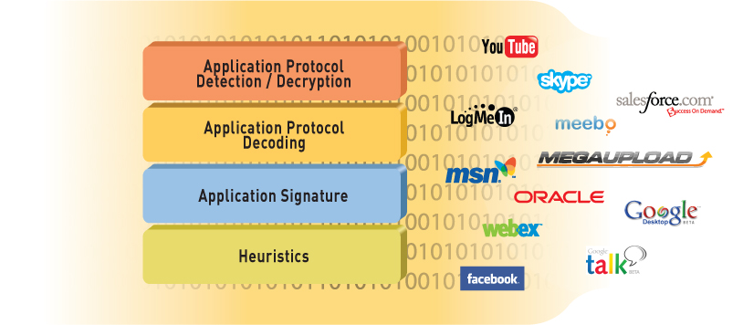
App-ID
Application Identification is at the core of PAN-OS Security, QoS, and PBF policies
Each session contains the information necessary to identify the applications traversing the firewall
Notes:
Accurate traffic classification is the heart of any firewall, with the result becoming the basis of the security policy. Traditional firewalls classify traffic by port and protocol, which, at one point, was a satisfactory mechanism for securing the perimeter. Today, applications can easily bypass a port-based firewall by hopping ports, using SSL and SSH, sneaking across port 80, or using non-standard ports. App-ID is the Palo Alto Networks traffic classification mechanism that addresses the traffic classification limitations that plague traditional firewalls.
App-ID uses multiple identification mechanisms to determine the exact identity of applications traversing the network. We will discuss these methods in the following slides.

Slide 5
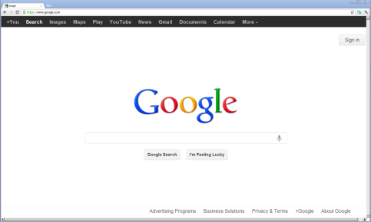







What is an Application?
Gmail
GoogleTalk
Google Calendar
Google
Sybase
eMule
UltraSurf
Notes:
The term “application” does not have an industry-accepted definition in the way that “session” or “packet” do. Applications can be delivered through a web browser, a client-server model, or a decentralized peer-to-peer design. In Palo Alto Network terms, an application is a specific program or feature that can be detected, monitored and blocked if necessary.
Applications will include business tools and services, which will need to be allowed, as well as entertainment or personal services, which may need to be blocked.

Slide 6
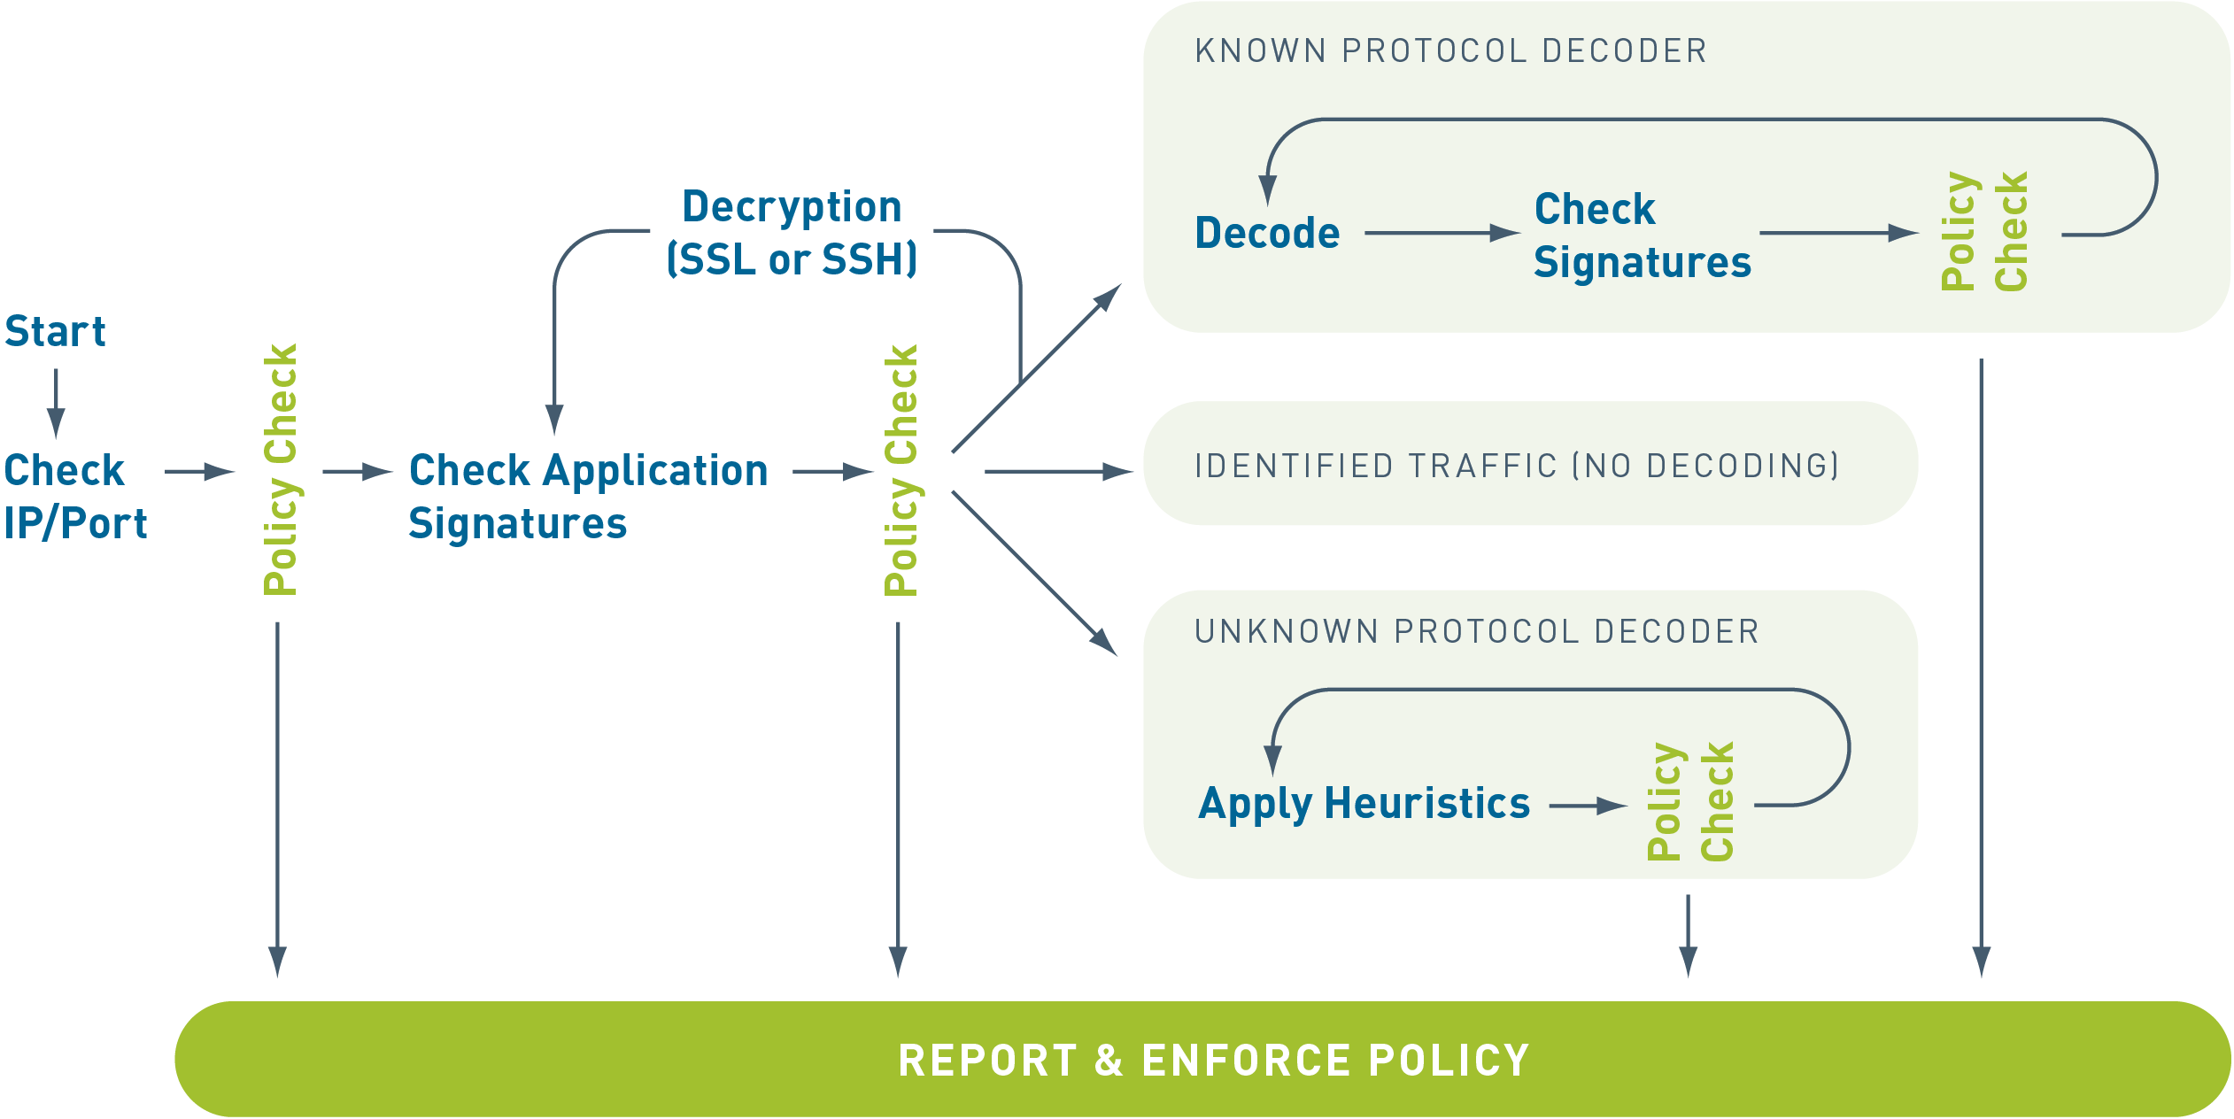
App-ID Flow
Notes:
App-ID uses multiple identification mechanisms to determine the exact identity of applications traversing the network. The identification mechanisms are applied in the following manner:
Traffic is first classified based on the IP address and port.
Signatures are then applied to the allowed traffic to identify the application based on unique application properties and related transaction characteristics.
If App-ID determines that encryption (SSL or SSH) is in use and a decryption policy is in place, the application is decrypted and application signatures are applied again on the decrypted flow.
Decoders for known protocols are then used to apply additional context-based signatures to detect other applications that may be tunneling inside of the protocol (e.g., Yahoo! Instant Messenger used across HTTP). For applications that are particularly evasive and cannot be identified through advanced signature and protocol analysis, heuristics or behavioral analysis may be used to determine the identity of the application.
Once the application is identified, the policy check determines how to treat the application: block, allow and scan for threats/file transfers/data patters, or rate limit them using QoS

Slide 7


Evasive Applications
✗
Port 5050
Blocked
Yahoo Messenger
Port 80
Open
BitTorrent Client
✗
Port 6681
Blocked
Port-Based Firewall
Notes:
One category of applications that are difficult to track and control are those applications that change port as needed. These applications are known as “evasive applications.” In a traditional firewall, Yahoo Messenger is defined as any TCP traffic destined for port 5050. In reality, Yahoo Messenger can automatically try other common ports, including port 80, if port 5050 is blocked.
Other applications can be configured by the user to be evasive by using a non-standard port. The BitTorrent client traditionally uses a port of 6681 or greater. It is a simple procedure to force BitTorrent to use a common port like 80 instead.
There are a number of application proxies out there that will take well-behaved, fixed-port applications and tunnel them through any port the user wants. The net result is that the destination port of any given connection has no bearing on the service or application that is generating the traffic.

Slide 8
Scenario 1: DNS Traffic
Legacy Firewalls
Palo Alto Networks Firewalls
with App-ID
Firewall Rule: ALLOW Port 53
Firewall Rule: ALLOW DNS
DNS
✔
DNS
DNS
✔
DNS
Firewall
Firewall
Bittorrent
✔
Bittorrent
Bittorrent
✗
Packet on Port 53:
Allow
DNS=DNS:
Allow
Bittorrent≠DNS:
Deny
Packet on Port 53:
Allow
Visibility: Bittorent detected and blocked
Visibility: Port 53 allowed
Notes:
Traditional firewalls use port blocking to control traffic. To allow a service such as DNS, the firewall is configured to allow port 53 traffic.
On a Palo Alto Networks firewall, a rule is created to allow the DNS service rather than a specific port.
In this example, the end result is the same: DNS traffic is allowed. However, this will not protect the network from other services using the same port.

Slide 9
Scenario 2: BitTorrent with Application IPS
Legacy Firewalls
Palo Alto Networks Firewalls
with App-ID
Firewall Rule: ALLOW Port 53
Firewall Rule: ALLOW DNS
Application IPS Rule: Block Bittorrent
DNS
✔
DNS
✔
DNS
DNS
✔
DNS
Firewall
App IPS
Firewall
Bittorrent
✔
Bittorrent
✗
Bittorrent
✗
Packet on Port 53:
Allow
DNS=DNS:
Allow
Bittorrent:
Deny
Bittorrent ≠ DNS:
Deny
Visibility: Bittorrent detected and blocked
Visibility: Bittorrent detected and blocked
Notes:
An application intrusion protection system (IPS) can be added to a traditional firewall environment to provide a second layer of traffic filtering. Once the traffic is processed by the firewall, it is passed to the application IPS for further analysis. In our example, BitTorrent traffic sent on port 53 will traverse the firewall because it is using an allowed port, but will be blocked by the application IPS.
The Palo Alto Networks solution is still to allow only DNS. Any traffic not specifically allowed will be denied. The end result is the same as if we were to block the BitTorrent application explicitly. The port number does not matter since we are checking for the application directly.
As in the previous example, the end result is the same for both solutions: BitTorrent traffic is blocked.

Slide 10
Scenario 3: Zero-day Malware
Legacy Firewalls
Palo Alto Networks Firewalls
with App-ID
Firewall Rule: ALLOW Port 53
Firewall Rule: ALLOW DNS
Application IPS Rule: Block Bittorrent
Firewall
App IPS
Firewall
DNS
✔
DNS
✔
DNS
DNS
✔
DNS
Bittorrent
✔
Bittorrent
✗
Bittorrent
✗
Zero-day C & C
✔
Zero-day C & C
✔
Zero-day C & C
Zero-day C & C
✗
Packet on Port 53:
Allow
DNS=DNS:
Allow
C & C ≠ Bittorrent:
Allow
Command & Control ≠ DNS:
Deny
Visibility: Packet on Port 53 allowed
Visibility: Unknown traffic detected and blocked
Notes:
In the previous two examples, we were dealing with a well-behaved, known threat. The situation changes if the threat is unknown, like a zero-day virus.
In the application blade example, the zero-day virus using port 53 is allowed through the firewall because it is using an allowed port. However, since the application blade does not know about this new threat, the malware is not blocked and is passed onto the network. This is an inherent problem with application block policies – you cannot block what you do not know. Not only does the 0-day malware gets through, but there are no logs generated that identify this problem!
The Palo Alto Networks firewall is configured to allow only DNS traffic. Even if the zero-day malware is unknown to PAN-OS, it is not allowed to pass since it does not match the allowed DNS service. Additionally, traffic that fails due to policy is logged for later analysis.

Slide 11
App-ID filter vs. URL Filtering
App-ID filtering
Application signature based
Multiple Applications can be run from one web page
Example:
facebook-base, facebook-apps, facebook-chat, facebook-mail, facebook-posting
URL Filtering
URL based
Manages HTTP and HTTPS traffic only
Content from multiple web sites can be loaded onto one web page
Example:
www.facebook.com
Notes:
In some discussions, App-ID is compared to URL filtering. Although both can be implemented in PAN-OS, the two features are used to achieve different goals.
App-ID exists to identify applications traversing the network. The App-ID engine reads the application signature to uniquely identify the application, regardless of the port or address information associated with the traffic. This type of precision could be used to allow a network user to access the general functionality of the Facebook web site (facebook-base) but deny the ability to chat with other Facebook users (facebook-chat). App-ID can be applied to all types of network traffic handled by a Palo Alto Networks firewall.
URL Filtering is a feature of the Content-ID engine. URL filtering processes traffic solely based on the URL associated with the traffic. Nothing else in the packet is evaluated during this check. URL filtering will simply deny access to the specified website through HTTP and HTTPS.
App-ID and Content-ID are separate engines in the Single Pass Architecture. URL filtering will be discussed in more detail later in the course.

Slide 12
App-ID Components
Protocol Decoders
Application Signatures
Protocol Decryption
Heuristics
Detect Protocol in Protocol within a session
Provide context for Application Signatures
Detect Layer 7 signatures within a session
SSL & SSH decryption
Looks for patterns of communication when no signature exists
Notes:
The Palo Alto Networks solution utilizes four major technologies to identify applications: protocol decoders, application signatures, protocol decryption, and heuristics. We will discuss each of these topics in the following slides.

Slide 13

Protocol Decoders
web-browsing
Application shift
Protocol Decoders
Facebook-base
Application shift
Application Signatures
Facebook-chat
Notes:
These software constructs understand the application at the protocol level and provide contexts for the application. For example, the HTTP decoder understands that there will be a Method and a Version for each HTTP request. The decoders are what assist in detecting when a second protocol is tunneled within an existing session. This is called “Protocol in Protocol.”

Slide 14
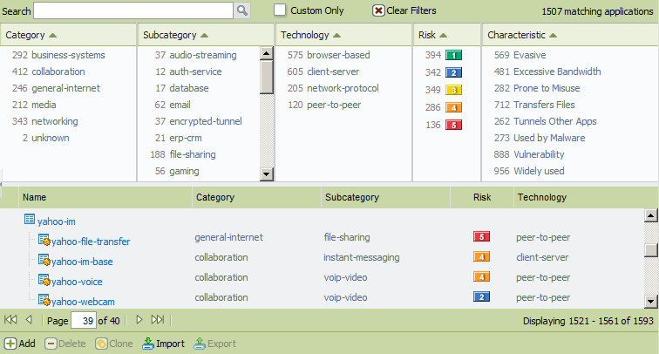
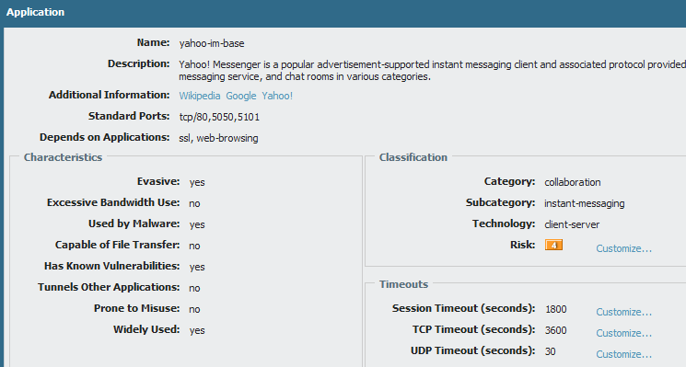
Application Signatures
Objects > Applications
Notes:
Palo Alto Networks maintains a database of known application signatures for use in the App-ID engine. Updates to the database are issued weekly.
You can view the application signatures in three ways:
In the GUI under Objects > Applications
On the web at http://apps.paloaltonetworks.com/applipedia/
On an Apple iOS device with the Applipedia app
Each signature covers multiple versions of an application.

Slide 15




Protocol Decryption
SSH Decryption
SSH Tunnel
SSH Tunnel
User
Server
Forward Proxy (Outbound SSL Decryption)
Internal User
External Server
Inbound SSL Inspection
External User
Internal Server
Notes:
The firewall can be configured to decrypt Secure Socket Layer (SSL) and Secure Shell (SSH) traffic going to external sites. With the SSH option, you can selectively decrypt outbound and inbound SSH traffic to assure that secure protocols are not being used to tunnel disallowed applications and content. You can also apply decryption profiles to your policies to block and control various aspects of SSL traffic. Assume a scenario where a user will be connecting via an encrypted connection to Facebook. The company policy is to allow employees to read Facebook, but prevent facebook-chat and facebook-posting. This can easily be accomplished with the Palo Alto Networks firewall if SSL decryption is enabled for the facebook application. If SSL decryption is not enabled, then the firewall cannot tell what application is inside the SSL connection, let alone that application shifts are occurring within the connection.
Decryption will be discussed in more detail later in this course.

Slide 16
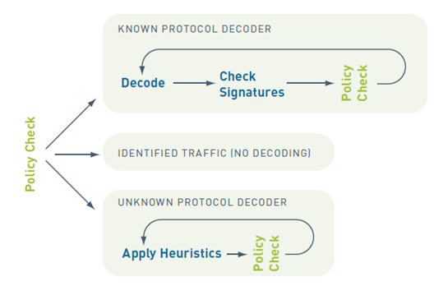
Heuristics
Notes:
When traffic is unable to be identified by the application decoders and signatures, the Heuristics engine is used. This engine looks at patterns of communication and attempts to identify the application based on its network behavior.
This type of detection is required for applications that use proprietary end-to-end encryption, such as Skype and encrypted BitTorrent.

Slide 17
Examining UDP Packets
Source Address
Destination Address
Destination Port
Application Data
00 1b 17 01 10 20 00 1c 23 07 42 5f 08 00 45 00
00 3b d1 26 00 00 80 11 54 18 0a 10 00 6e 0a 00
00 f6 c1 76 00 35 00 27 c7 5a a3 24 01 00 00 01
00 00 00 00 00 00 03 77 77 77 05 6d 65 65 62 6f
03 63 6f 6d 00 00 01 00 01
Notes:
When the PAN firewall examines UDP packets, it often only has to examine a single UDP packet to determine what the application is. In most cases, all the information the firewall needs is contained in a single packet. The above example shows a single packet DNS query for www.meebo.com. This packet contains all source and destination addressing information. It also includes the application data that will be used to identify the traffic so it can be processed by security policy.

Slide 18
Examining TCP Packets
TCP syn
Source Address
Destination Address
Destination Port
Application Data
00 1b 17 01 10 20 00 1c 23 07 42 5f 08 00 45
00 30 d1 29 40 00 80 06 8f 60 0a 10 00 6e d0 51
bf 6e 3a 52 01 bb 31 d7 06 19 00 00 00 00 70 02
ff ff 74 e4 00 00 02 04 05 b4 01 01 04 02
syn ack
ack
http get
http response
1f 8b 08 00 00 00 00 00 00 03 b4 57 fd 6f db 36
13 fe 57 ae 1a 36 3b 99 2d 35 fb 00 da c4 f6 b0
26 e9 bb bc 48 9a 60 75 57 0c 7d 8b 81 92 4e 12
63 89 54 49 2a ae 57 e4 7f df 1d 25 39 b2 f7 91
fe b0 37 08 60 ea 78 3c de 3d 7c ee 78 9c 3d 39
bb 3e 5d fe 7a 73 0e 3f 2d af 2e e1 e6 cd 8b cb
...........................................
Notes:
Applications that use TCP will usually not have all the required information in any single packet. The above example is of a HTTP connection to www.meebo.com. The first packet is a TCP SYN packet. While it does contain all the source and destination addresses, it contains no application data. In fact, the following two packets will also not contain any application data. They will just complete the three-way handshake. The actual application data will be either in the HTTP Get request or in the server reply.

Slide 19
Security Policy Configuration
Notes:
Applications that use TCP will usually not have all the required information in any single packet. The above example is of a HTTP connection to www.meebo.com. The first packet is a TCP SYN packet. While it does contain all the source and destination addresses, it contains no application data. In fact, the following two packets will also not contain any application data. They will just complete the three-way handshake. The actual application data will be either in the HTTP Get request or in the server reply.

Slide 20
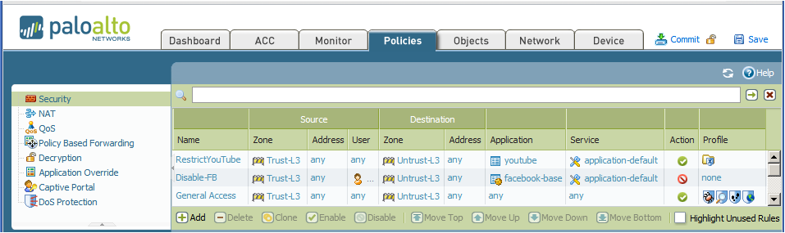
Security Policy
Policy list is evaluated from the top down
The first rule that matches the traffic is used
No further rules are evaluated after the match
Policies > Security
Notes:
When a session is initiated, the source and destination zones and addresses are determined and the policy rule base is checked. A rule base exists for each zone pair. Rules can be created with multiple zones as source and destination. This is commonly used to define access to a DMZ resource that is used in a similar fashion by clients in both internal and external zones.
If there is a rule that matches the addresses and could match the application, the session is allowed and the system begins to examine the traffic to determine the application in use. For this reason, it can be beneficial to configure specific or default ports for the applications being allowed. If the service is defined as any, all sessions must be allowed to proceed until the point where application-layer data is exchanged, and then the firewall can determine what application is inside the session. If the service is anything but any, then many unwanted connections can be dropped immediately. If the traffic and resulting application does not match any rule, the session will be dropped.
The policies are one-way, meaning that they only allow traffic initiated in the direction the policy specifies. The replies to the client are always allowed as part of the policy. However, if traffic is intended to be initiated in both directions then two policies will be required. For example, a policy from the Trust zone to the Untrust zone for web browsing would allow user web requests to go out and the http replies to return, but it would not allow an internet host to browse web pages on a user’s computer.

Slide 21
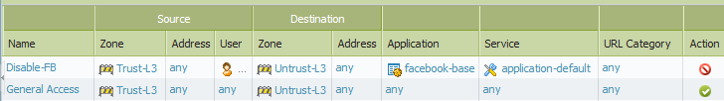
Security Policy Match Conditions
Policies > Security
Interfaces are assigned to Security Zones
User includes one or more individuals and/or groups
On HTTP and HTTPS traffic only
Address is one or more of:
Address
Address group
Block List
Region/Country-based enforcement
Application includes one or more of:
Applications
Application Groups
Application Filters
Notes:
Security policy consists of objects that describe the endpoints of the communication and the traffic to be matched. Rules can be as specific as required. They are built using objects that hold values of addresses, applications, users and services.
The configured action, deny or allow, is only taken if a session matches all defined fields of the security policy. If a match is not made, the session will be compared against the next policy in the list. Once a match is found, no further policies will be checked.

Slide 22
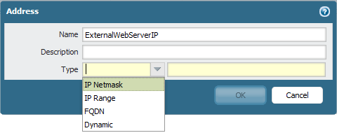
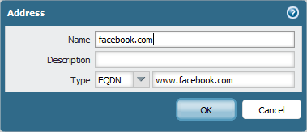
Address Objects
Created to reference frequently used IP addresses or ranges in configurations
Available types:
IP Netmask
IP Range
FQDN
Dynamic
FQDN type changes automatically if DNS entry updates
Notes:
Address objects are named objects configured on the firewall to make it easier for administrators to complete configurations with a pre-defined address. The Address object can be configured through the GUI at Objects > Addresses. Multiple address objects can be specified within a policy.
The FQDN fully qualified domain name address object is used to handle situations where an IP address might change or there are multiple IP address for a FQDN. This address object will auto-refresh based on the DNS TTL intervals. If the DNS-served IP address changes, the security policy will use the new address without any administrator changes to the firewall.

Slide 23
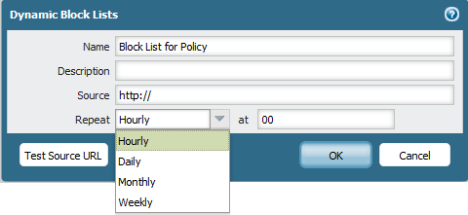
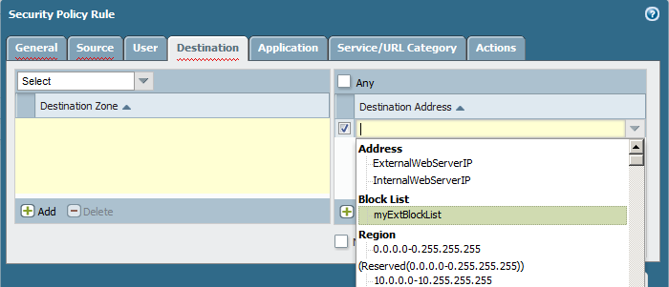
Dynamic Block Lists
Objects > Dynamic Block Lists
Allows the import of external lists from agencies which provide URL/IP block lists
Notes:
In addition to the Address objects, Dynamic Block Lists can be used to dynamically maintain address-based policies using block lists from companies or agencies which maintain such lists. For example, several groups on the internet maintain blacklists of known spam sites for email filtering.
The list is updated on a administrator-defined schedule. The updated information is immediately available for use in the policy, without a commit.

Slide 24
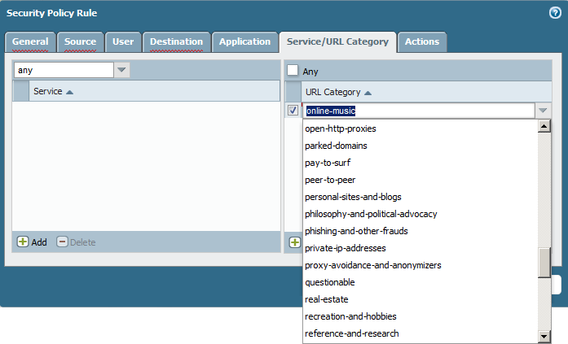
URL Category
For HTTP/HTTPS traffic only
Can include custom URL categories
Requires a license for non-custom URL categories
URL lookups are cached for faster retrieval
Notes:
The URL Category match criteria is used in three different policy types: Security, QoS, and Captive Portal. This field will match URLs against predefined categories provided by the dynamic updates. In addition to the categories provided by Palo Alto Networks, you can create custom URL Categories. This feature requires the URL-filtering license except for custom categories. If the license expires, only custom categories will be used by the policy.
Policy lookup occurs each time the URL Category for the session changes. Traffic logs will show entries for each URL category transition. Lookups are cached for faster retrieval. The engine will check the data plane cache, then the management plane cache before querying the external URL lookup servers. If the category is not resolved before the webserver responds, the security policy will look for a match on a not-resolved category.
URL Category matching uses the same Block page as the URL Filtering profile and does not have either the Continue or Override option.
If more granular URL filtering is required, a URL Filtering profile should be used instead. The URL Filtering profile can match specific URLs (e.g., www.facebook.com), while the URL Category only matches broad categories (e.g., social-networking). We will discuss URL Filtering profiles in more detail in the Content-ID module.

Slide 25
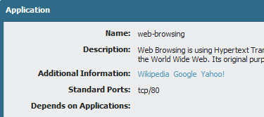
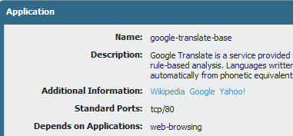
Security Policy Dependencies
Parent applications must also be allowed by security policy for the dependent applications to function.
web-browsing
Allow | Deny
Application shift
Google-translate-base
Allow | Deny
Notes:
Many applications rely on other applications to be running before they can be used. In a Palo Alto Networks firewall environment, you must make sure that an application’s parent applications are allowed in order for your target application to function correctly.
For example, a user wants use Google Translate. Applications accessed through a web browser will first be recognized as an HTTP session. The administrator will have to enable the web-browsing application in addition to allowing the google-translate-base application.
Application dependencies can be found by accessing App-ID in the GUI. Click Objects > Applications to see application information. The App-ID listings are also available through Applipedia.

Slide 26
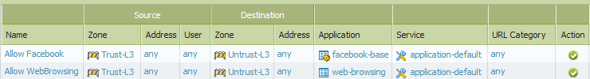
Implicit Application Dependencies
PAN-OS implicitly allows parent applications for a set of commonly used applications
In this example, Facebook access will work even if the Allow WebBrowsing policy were removed.
Notes:
Requiring that dependencies be allowed in order to enable an application can often allow more traffic than intended. For example, enabling access to web-browsing just to allow facebook-base allows users to browse other sites, requiring the administrator to configure other policies to regulate this access.
PAN-OS addresses this concern by implicitly allowing dependencies for a set of commonly used applications to streamline the security policy process. Implicit permissions of a parent application are only handled if there is no match with an explicit rule.
The complete list of implicitly allowed applications can be found in Appendix B of this manual.

Slide 27
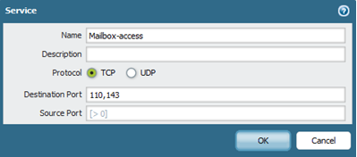
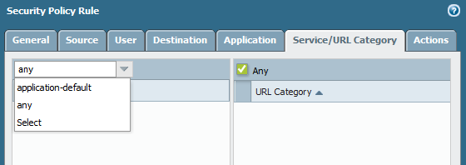
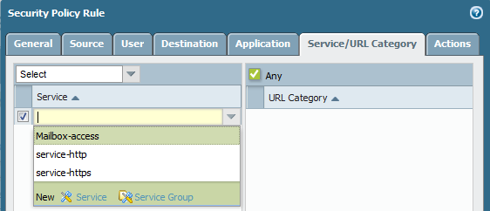
Using Port Numbers in Security Policies
Objects > Services
Policies > Security
Notes:
Security policies on a PAN-OS firewall will match source, destination, application and service. The application and service columns specify what applications can be identified on a defined set of ports, or on all available ports. The service column allows administrator to select one of the following:
Application-default: The service application-default option will set the security policy to allow the application on the standard ports associated with the application.
service-http or service-https: The pre-defined services use TCP ports 80 and 8080 for HTTP, and TCP port 443 for HTTPS. Use this security policy setting if you want to restrict web browsing and HTTPS to these ports.
Any: The predefined service Any matches any TCP/UDP port. This service is typically used to deny applications.
Custom service: Administrators can create their own definition of TCP/UDP port numbers to restrict applications usage to specific ports.
Using the service application default is the recommended practice for configuring a security policy to allow the applications.
For more information, refer to the Security Policy Guidelines document on the support website.

Slide 28

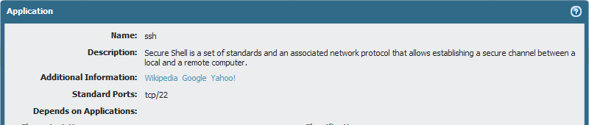
Application Default
Policies can be configured to only match if applications with well-known port numbers are found on the expected port
Example:
The Application Default for SSH is expected on TCP port 22
With application-default in the Service column, the policy will only match if the Application matches SSH and is using TCP port 22
Notes:
In order to limit services to their published default port values, policies can be configured with the application-default setting. With this setting configured, the policy will only match if the port number associated with the session matches the port listed in the matched application’s entry in the App-ID database. This feature is intended to limit port hopping and port spoofing.

Slide 29

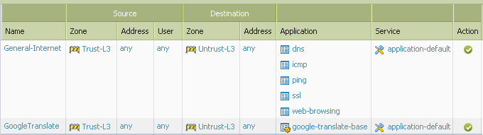
Security Policy Example: http-get
Address Group:
“Local-Net” 192.168.0.0 /16
Joe
http://translate.google.com
192.168.15.22
Destination Port: TCP 80
74.125.224.64
Zone: Trust-L3
Zone: Untrust-L3
Notes:
In our example, user Joe wants to access the website http://translate.google.com across the firewall. Joe’s computer is in the Trust-L3 zone and the firewall interface connected to the public internet is in the Untrust-L3 zone.
When Joe opens a browser connection to the website, a session is started. The firewall scans the traffic and finds the application signature for the http-get process, which matches the web-browsing application in App-ID. Based on the source and destination addresses, the firewall determines that the traffic is flowing from Trust-L3 (source) to Untrust-L3 (destination) zones. These are the only parameter needed to match the General Internet policy so the traffic is allowed. The GoogleTranslate rule is not checked at this time since a match has already been found.
However, connecting to the website and actually using Google Translate are two different events. We will evaluate that action in the next slide.

Slide 30

Security Policy Example: Google Translate
Address Group:
“Local-Net” 192.168.0.0 /16
Joe
http://translate.google.com
192.168.15.22
Destination Port: TCP 80
74.125.224.64
Zone: Trust-L3
Zone: Untrust-L3
Notes:
Security policies are constantly be examined, for every packet that traverses the firewall, for the life of the session. The firewall can detect application shifts, or changes, within an established session.
After Joe connects to the website, he tries to access Google Translate, initiating an application shift in the current session. The App-ID engine detects the shift and finds the application signature for google-translate-base. The session still exists between Trust-L3 and Untrust-L3.
Using these three conditions (Application, Source Zone, Destination Zone), the first rule is checked. There is no match since google-translate-base does not match the applications listed in the rule so the firewall moves on to the next rule. The second rule matches on all conditions and google-translate-base is allowed to run.
Does the order of the two rules matter in this example? In this example, the order is not relevant. Traffic which matches one rule cannot match the other rule so neither rule prevents the other from being evaluated.

Slide 31
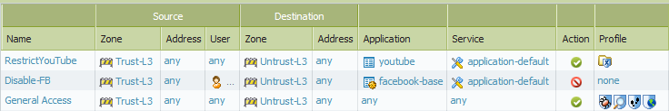
Security Profiles
Policies are processed in two steps
Step 1: Check to see if traffic matches security policy
If Action is set to Deny, packet is dropped
If Action is set to Allow, go to step 2
Step 2: Apply Security Profiles, if configured
Policies > Security
Step 1:
Security Policy
Step 2:
Security Profile
Notes:
Each security policy can include specification of one or more security profiles, which provide additional protection and control. The profile associated with a security policy is only evaluated on a policy match where the configured action is allow.
In additional to individual profiles, you can create profile groups to combine profiles that are often applied together.

Slide 32

Security Profile Types
Policies > Security
Antivirus
Vulnerability
Anti-Spyware
URL Filtering
File Blocking
Data Filtering
Policy Group
Notes:
The following profile types are available for security policies:
Antivirus: Protects against worms and viruses , blocks spyware downloads
Anti-spyware: Blocks attempts by spyware to access the network.
Vulnerability: Stops attempts to exploit system flaws or gain unauthorized access to systems
URL filtering: Restrict access to specific web sites and web site categories
File blocking: Blocks selected file types
Data filtering: Prevents sensitive information such as credit card or social security numbers from leaving the area protected by the firewall
Security Profiles will be discussed in more detail in the Content-ID module.

Slide 33
Security Policy Administration
Notes:
The PAN-OS GUI displays a large amount of information about the policies configured on the firewall. To limit the amount of information displayed, you can customize the columns shown. Hover the cursor over any column name to expose the pull-down.

Slide 34
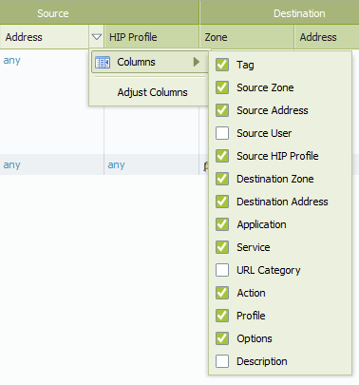
Displaying Policy Columns
To minimize screen sprawl, columns can be selected, deselected, and resized
Notes:
The PAN-OS GUI displays a large amount of information about the policies configured on the firewall. To limit the amount of information displayed, you can customize the columns shown. Hover the cursor over any column name to expose the pull-down.

Slide 35
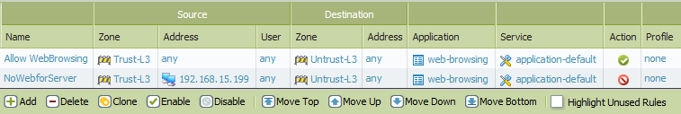
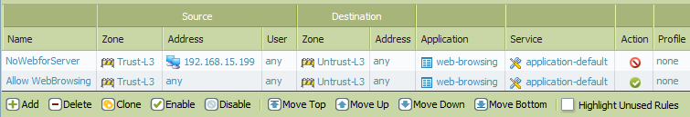
Managing Policy Rows
Select a Policy then: Delete, Clone, Enable, Disable, Move
Policies can be added new or cloned from existing policy
Use Highlight Unused Rules to determine which policies have not matched any traffic since last reboot
Policies can be reordered to match requirements
Notes:
Individual policies can be managed using the toolbar at the bottom of the Policy pages. Locally-defined policies can be created, deleted, cloned, enabled, and disabled. Policies pushed to the firewall by Panorama must be edited from the Panorama server.
The Highlight Unused Rules option allows you to see which rules have not matched any traffic since the last reboot of the firewall. This is most often use to troubleshoot misconfigured policies.
Controls also exist to reorder the policies. Incorrect order can prevent policies behaving as designed. In the example, an administrator wanted to allow web browsing for all systems except the server at IP address 192.168.15.199. However, with the deny rule appearing after the more general allow rule, the server would still be able to browse the web. Selecting the AllowWebBrowsing policy and clicking Move Down will arrange the rules so that they will be evaluated in the correct order to deny the server. Policies can also reordered by dragging the entry to a new position with the mouse.

Slide 36
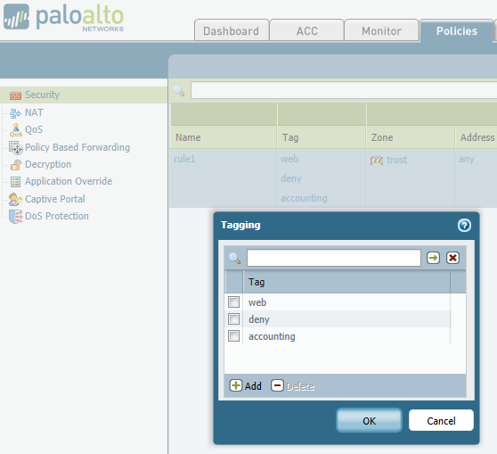
Security Policy Admin | Tags
Notes:
Tags assign keywords to policies to allow administrators to search the policies. This is purely an administrative tool – tags do not affect how policies are evaluated.

Slide 37
Application Filters and Groups
Application Filters
Dynamic grouping of individual App-ID’s based on App-ID attributes:
Category
Subcategory
Technology
Risk
Characteristic
Application Groups
Aggregates of:
Individual App-ID’s
Application Filters
Nested Application Groups
Notes:
Security policies are based primarily on App-ID. Since the App-ID database is ever growing, PAN-OS allows for the dynamic grouping of App-ID signatures through Application Filters. As new applications are added to the App-ID database and categorized, policies based on these filters automatically will check for these new entries without any manual reconfiguration.
Application Groups are static, user-defined sets of applications, application filters, and other application groups. They allow the firewall administrator to create logical grouping of applications that can be applied to policies. Application groups are not updated with App-ID database changes.

Slide 38
Application Filters and Groups Hierarchy
Security Policy
Notes:
Applications are automatically added to matching application filters when added to the App-ID database.
Application groups can be manually configured to include applications, application filters, and other applications groups.
Firewall policies can be configured to match discovered application signatures against applications, application filters, or application groups.

Slide 39
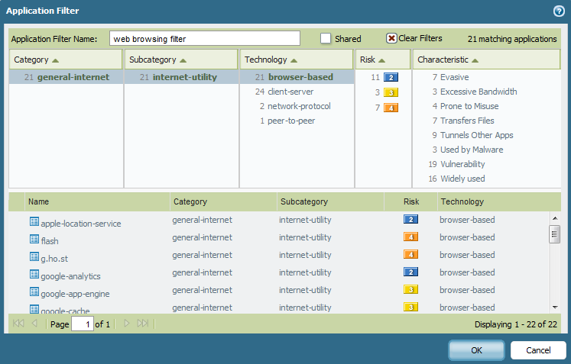
Example: Filtering Web-browsing Applications
As new Application signatures are released, those App-IDs will be automatically included in the filter
Objects > Application Filters > Add
Notes:
As applications are added to the App-ID database during the weekly updates, they are classified by category, subcategory, technology, risk, and characteristic.
To create an application filter, click Objects > Application Filters > Add. Name the filter and select the filter criteria. The filter will create a list of all applications which meet your parameters, based on the current App-ID database. As new App-IDs are added with predefined properties which match your filter settings, they are automatically added to the matching filter and will be checked the next time the filter is used by the security policy.

Slide 40
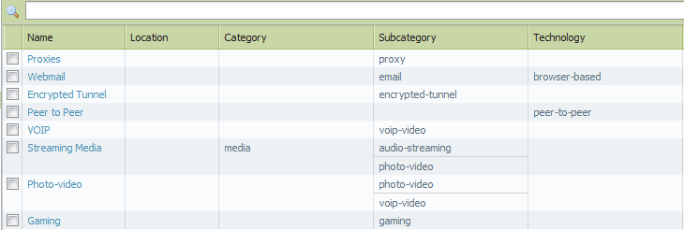
App-ID Filters Example
Used to cover families of applications
Objects > Application Filters
Notes:
Filters do not need to be complex to work. Many times, the subcategory will be enough. Selections such as gaming or proxy applications will be immediately useful in security policy.

Slide 41
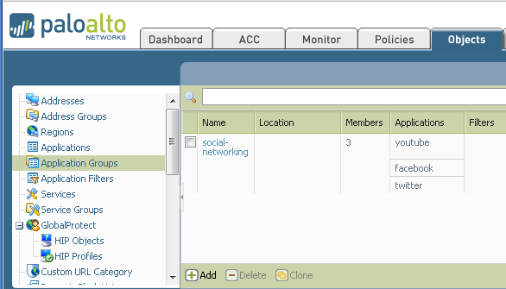
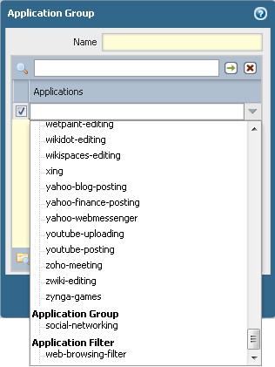
Application Group
Application Groups can contain applications, filters, or other application groups
Notes:
If you need to group specific applications, application groups allow administrators to create custom lists of applications for policies to check. Application groups can be combine applications, application filters, and application groups into a single entry which can be added to security policies. Application groups are not automatically updated when new applications are added to App-ID unless the group contains a filter which contains the new signature.

Slide 42
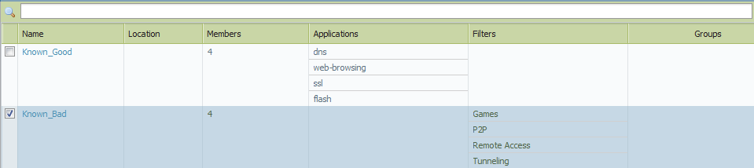
Application Group Example
Known_Good
Static Group of Applications
DNS
Web-browsing
SSL
Flash
Known_Bad
Static Group of filters and applications
Games
P2P
Remote Access
Tunneling
Objects > Application Groups
Notes:
In this example, the sets applications that the administrator wants to allow and deny do not fit into any application filter search. This administrator finds it more convenient to manually list the applications. However, any new applications added to App-ID will not automatically populate these groups.

Slide 43
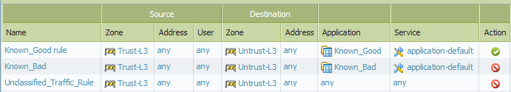
Security Policy Example
Requirements:
Process known good and bad applications
Determine what other applications are present in network traffic for future classification
Policies > Security
Notes:
The administrator in this example was given a list of applications to allow and deny on the network. However, the company acknowledges that they do not know all of the applications that users are using. The administrator is to set up allow and deny policies and determine what other applications are in use so they can be added to the allow or deny lists.
The first rule created allows the list of allowed applications to pass through the firewall. The second rule denies the applications disallowed by company policy.
The last rule will match any traffic not caught by the first two rules. Whether it is set to allow or deny the traffic, any traffic matched by this rule will be logged by the firewall. The administrator can then use the logs to identify application in use on the network and add them to the appropriate application group.

Slide 44
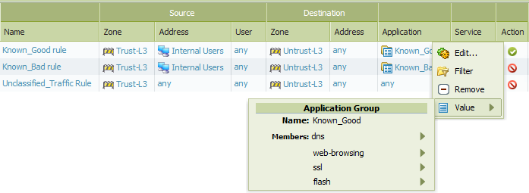
Displaying Application Information
Displays detail information for:
Applications
Application Containers
Filters
Application Groups
Notes:
In previous versions of PAN-OS, there was no easy way to understand which applications were included in the groups, filters, or containers associated with a policy. You would have to the Objects tab to view information about application groups, filters, or individual applications.
PAN-OS now allows you to view the contents of these objects from the policy page. Clicking on the name of the object allows you to see information about the object and the contained components.
Address objects, such as Internal Users in this example, can also be expanded in the policy window for additional information.

Slide 45
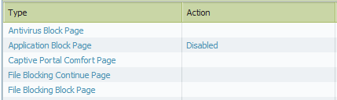
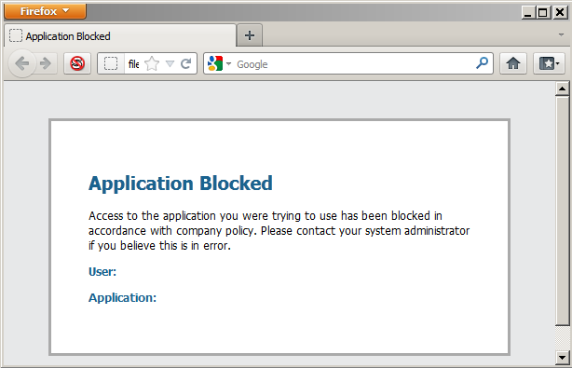
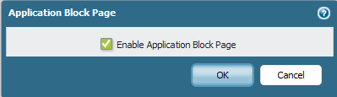
Application Block Response Pages
When a Security Policy blocks a web-based Application, a response page can be displayed on the user’s browser.
Device > Response Pages > Application Block Page
Notes:
By default, if a policy denies a web-based application, the user will simply get generic browser-based error pages. In many cases, this results in additional support calls because users assume network problems rather than a policy violation. Custom response pages can be created to notify users when their action is blocked by firewall policy.
The default response page will include the prohibited application name, as well as the username (if User-ID is enabled).
Application block response pages do not require an interface management profile to be set.

Slide 46
Logs and Reporting

Slide 47
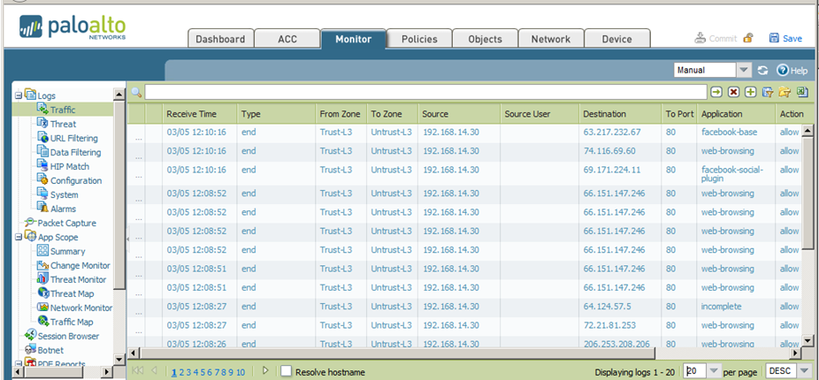
Viewing Logs
Monitor > Traffic
Notes:
All traffic crossing a Palo Alto Networks firewall will need to be allowed by security policy. The default settings for a security policy is to create a traffic log entry at the end of a session. This allows the log to include the total time of the session and the amount of data transferred. If there are any explicit deny policies in the security rule set they will be logged here as well.
The log viewer can be set to refresh at a specified interval or it can be refreshed manually. The number of entries displayed can also be adjusted.

Slide 48
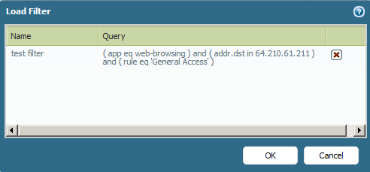
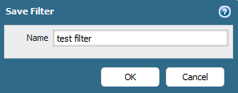
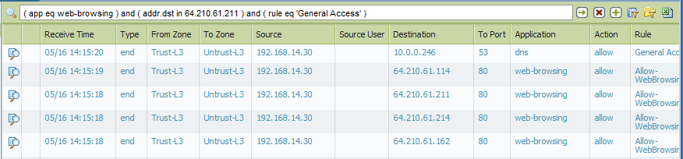
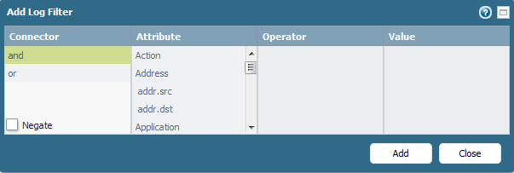
Log Queries
Notes:
The filter bar allows administrators to display only the lines in the log which match specified criteria. Values can be entered by clicking portions of the log entries or manually through the Add Log Filter interface. Frequently used filters can be saved and reused.

Slide 49

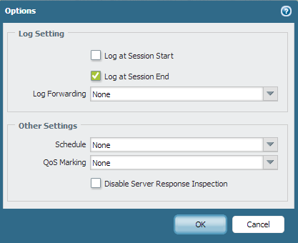
Configuring Log Generation
By default, logs are generated at the end of a session
Policies > Security
Notes:
Traffic logs are generated when a security policy matches and allows or denies a session to connect. By default, the policy logs these actions at the end of a session. This setting can be changed either in the Actions tab when creating a new policy or by clicking the entry in the Options column of the policy entry.
The advantage to the Log at Session Start option is that state transitions are only logged at the beginning of the session. The disadvantage of the option is that it will fill up the logs faster. Best practice is to only enable logging at session start when troubleshooting sessions.

Slide 50
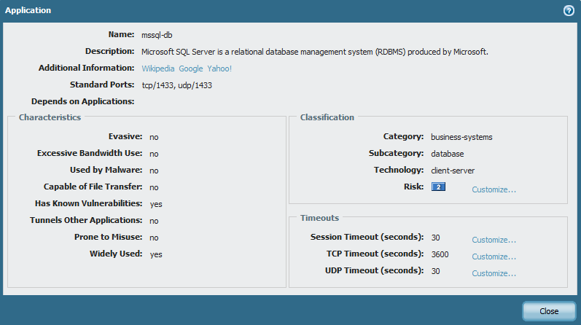
Customize Application Settings
Objects > Applications
Notes:
For security policies set to log at the end of a session, you must consider the nature of the applications being monitored. Sessions that are not closed properly will eventually time out, based upon the application timeout settings shown above. Timeout can be configured in the application signature.

Slide 51
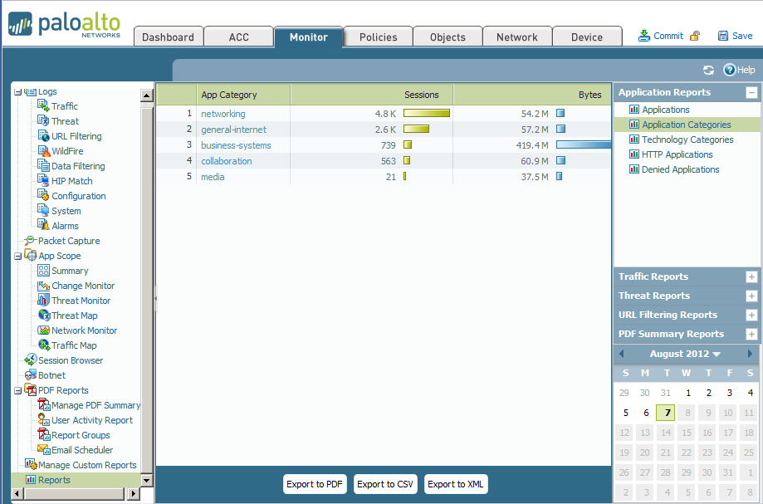
Viewing Reports
Notes:
The firewall provides various “top 50” reports of the traffic statistics for the previous day or a selected day in the previous week. To view the reports, click the report names on the left side of the page under the Monitor tab.
By default, all reports are displayed for the previous calendar day. To view reports for any of the previous days, select a report generation date from the Select drop-down list at the bottom of the page.
The reports are listed in sections. You can view the information in each report for the selected time period. Reports can be saved to your local system in either CSV or PDF format.

Slide 52
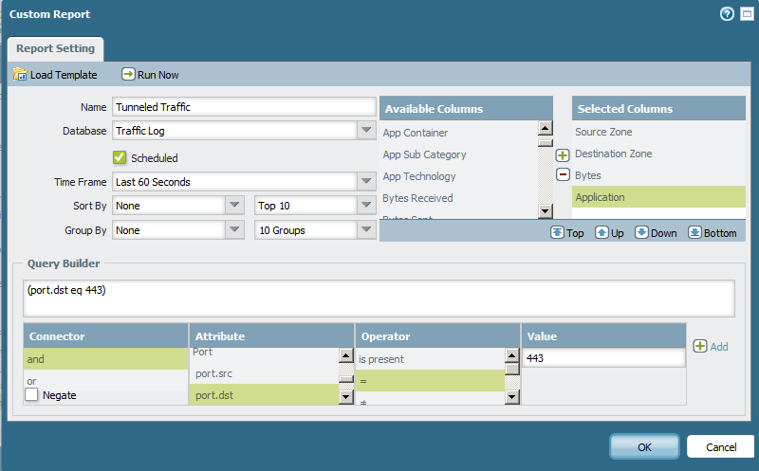
Creating Custom Reports
Monitor > Manage Custom Reports
Pulls report from Database
Will run daily at 2am
Time frame
Same query builder as for Logs
Notes:
In addition to the pre-built reports, PAN-OS provides an interface for creating custom reports.
There are three main steps to creating a custom report:
Select the database that the system will use for the report. There are eight databases to choose from. The Application Statistics database is focused on applications and application categories. It does not provide source and destination addressing information, but it does provide sub-totals of traffic. The other databases draw from the threat and traffic logs. Each has the option of using the logs themselves as a source, providing all of the fields visible in the log viewer, or of using a summary database. The summary databases have fewer fields but provides subtotals for sessions and byte counts.
Select columns that will appear in the report. Based on the source of the report, various columns can be chosen and ordered for the report. The report can also be given a name, a field to sort on, and the number of entries can be selected. Columns are chosen from the Columns pull-down and then reordered by dragging them on the screen.
Create filters for report data. Multiple filters can be created to control what data ends up in the report. Any field from the data source can be used in the filter definition. In the example above, a filter is created to choose only applications that were running on port 443. This port is usually identified as SSL, so this would represent all applications running over SSL that were detected by the device.

Slide 53
Summary
Application Identification (App-ID)
Security Policy Configuration
Match Conditions and Objects
Application Dependencies
Security Policy Administration
Managing Displays
Managing Policy Behavior
Logs and Reporting

